Slide 1
PD
n5zcs\event06.eeg
05:13:26
Seizure, sleeping (slight movement at the end of the seizure)
Bipolar montage
30 mm/sec
70uV/cm
Strips: sensitivity 300
Thalamic: sensitivity 35, High cut 500
Notes:
En una diapositiva pone: next SPES contacts 2,3 thalamus and 3,4 left thalamus, channels t6 and 02 will be the other thalamic channels not used for SPES) comprobar

Slide 2
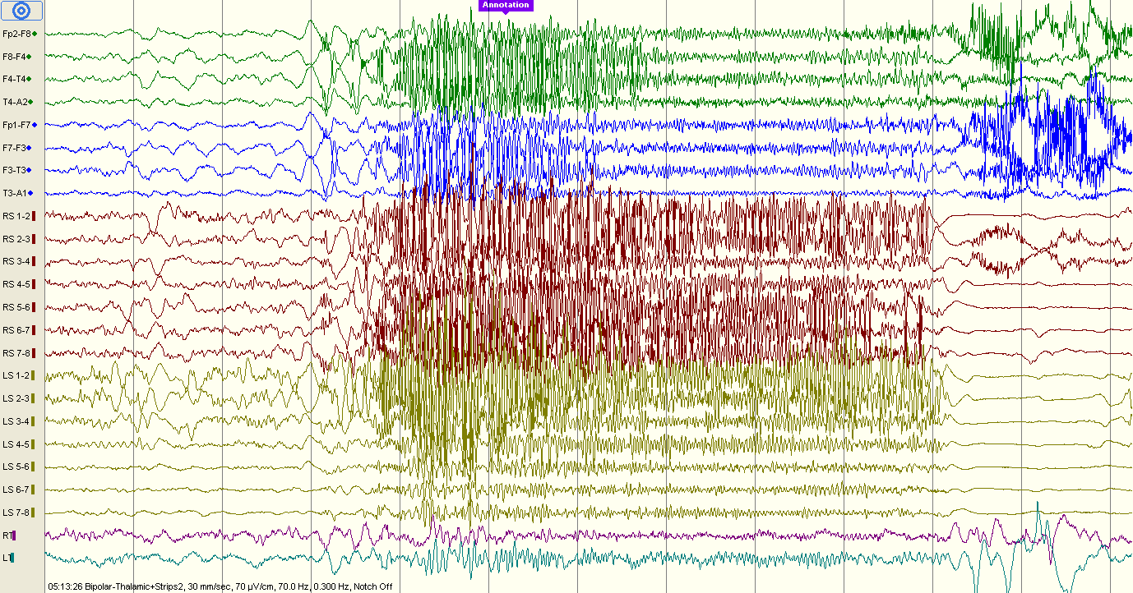

Slide 3
PD
n5zcs\event07.eeg
23:32:27
Seizure, sleeping (slight movement at the end of the seizure)
Bipolar montage
30 and 60 mm/sec
70uV/cm
Strips: sensitivity 300
Thalamic: sensitivity 35, High cut 500

Slide 4
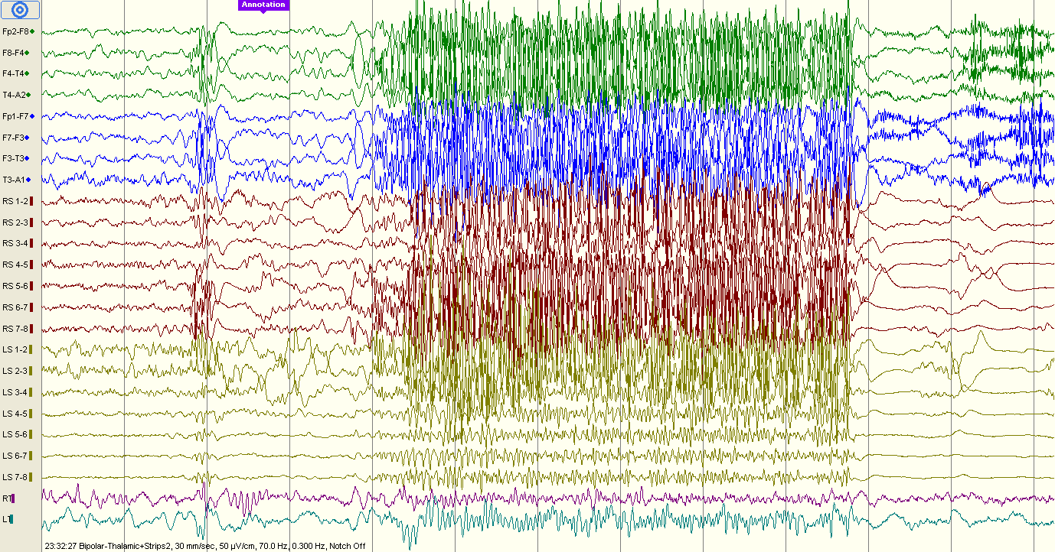

Slide 5
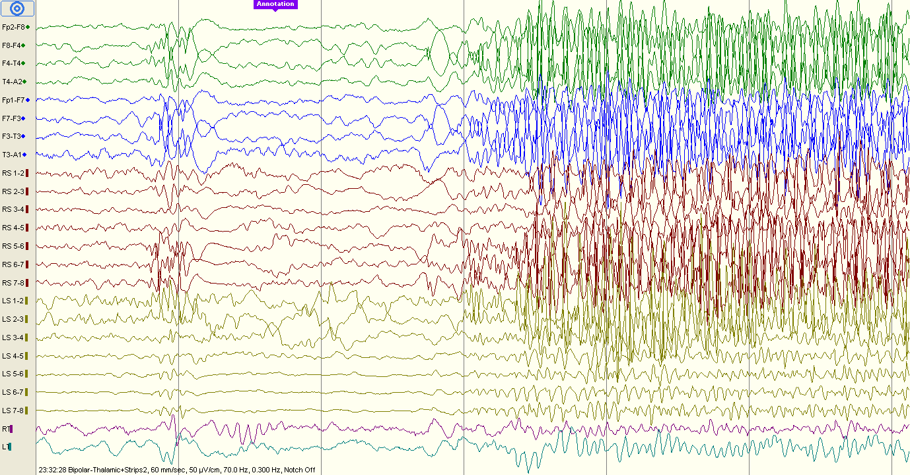

Slide 6
PD
n5zcs\event08.eeg
00:06:24
Seizure, sleeping (eyes and head movement at the end of the seizure)
Bipolar montage
30 mm/sec
70uV/cm
Strips: sensitivity 300
Thalamic: sensitivity 35, High cut 500

Slide 7
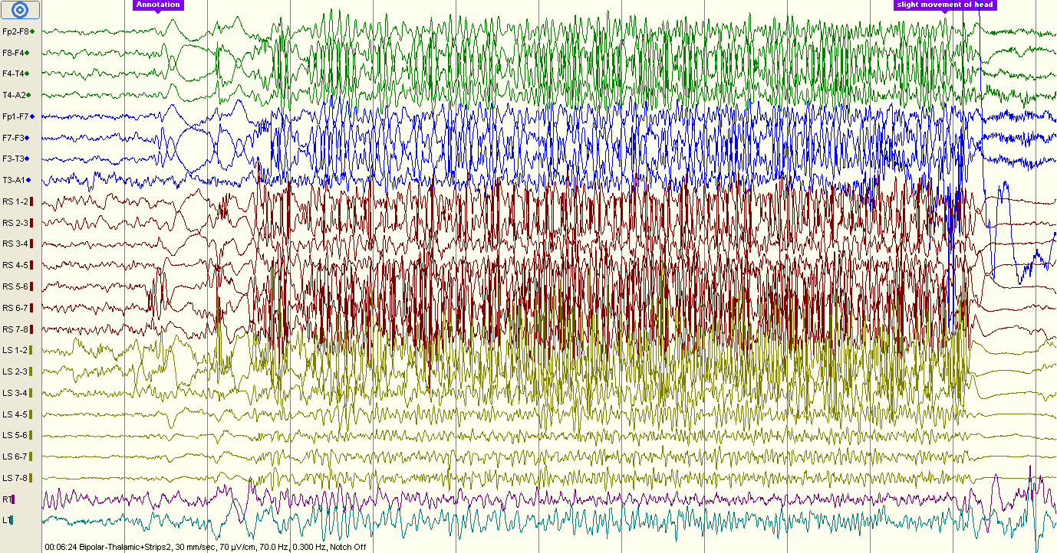

Slide 8
PD
n5zcs\event09.eeg
01:31:12
Seizure, sleeping (slight movement at the end of the seizure)
Bipolar montage
30 and 120 mm/sec
70uV/cm
Strips: sensitivity 300
Thalamic: sensitivity 35, High cut 500

Slide 9
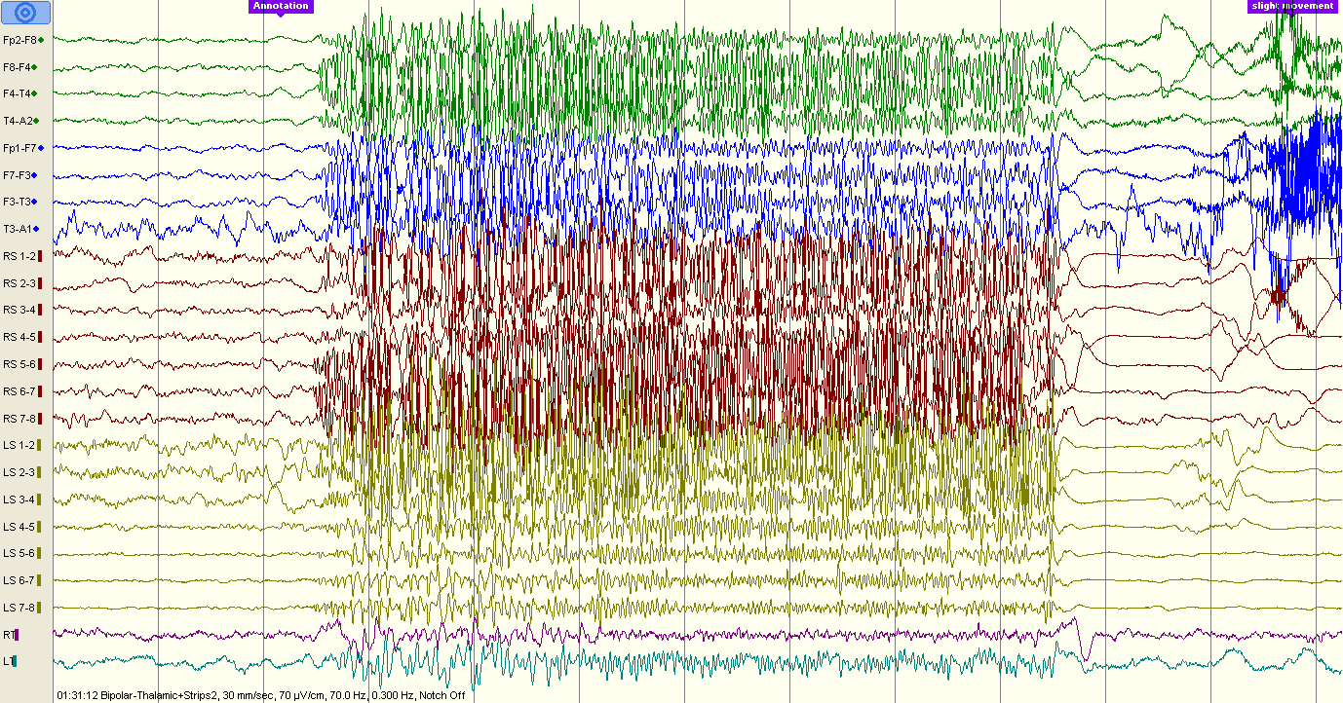

Slide 10
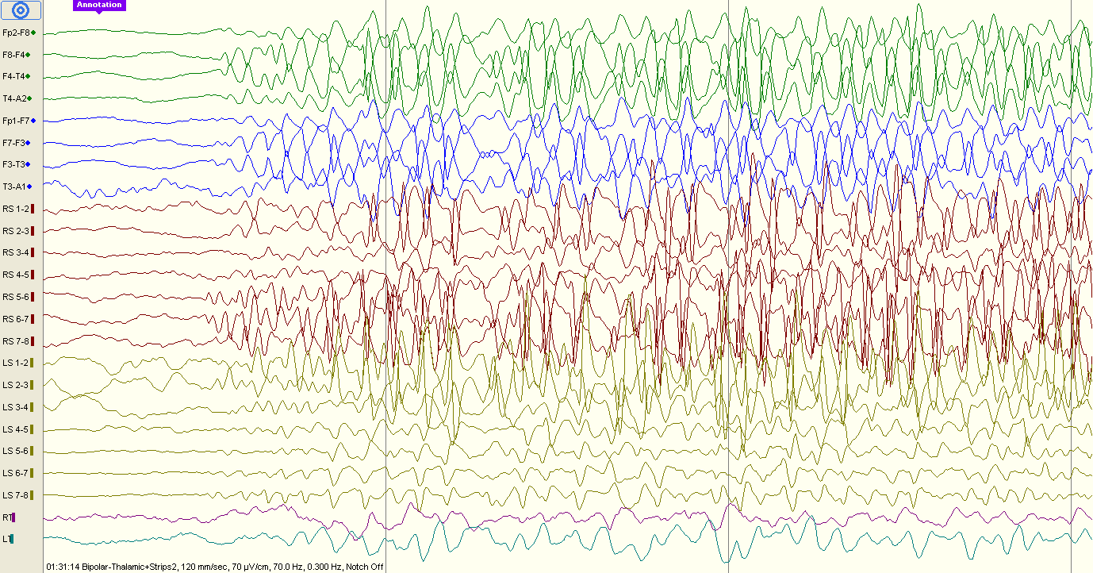

Slide 11
PD
n5zcs\event10.eeg
08:57:11
Seizure, sleeping (slight movement at the end of the seizure)
Bipolar montage
30 mm/sec
70uV/cm
Strips: sensitivity 300
Thalamic: sensitivity 35, High cut 500

Slide 12
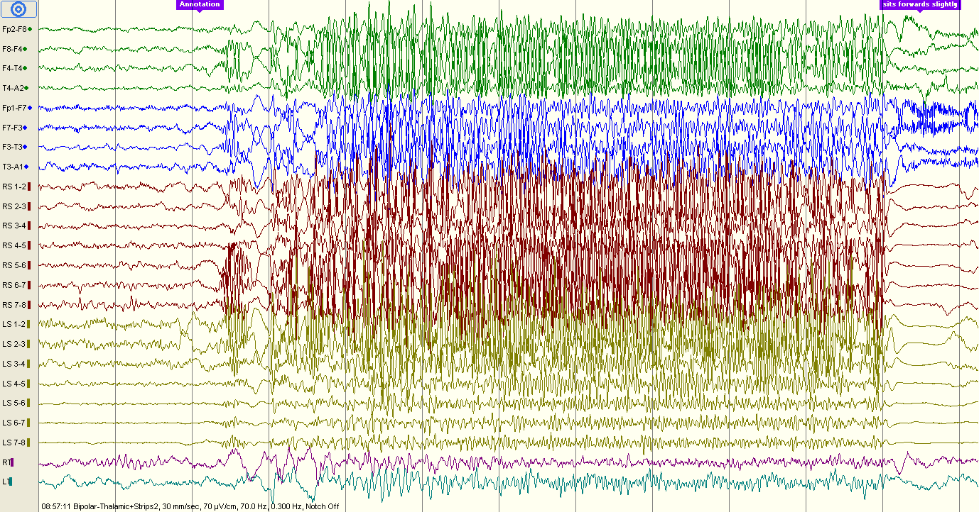

Slide 13
PD
n5zcs\event12.eeg
09:13:03
Interictal activity
Bipolar montage
30 mm/sec
70uV/cm
Strips: sensitivity 300
Thalamic: sensitivity 35, High cut 500

Slide 14
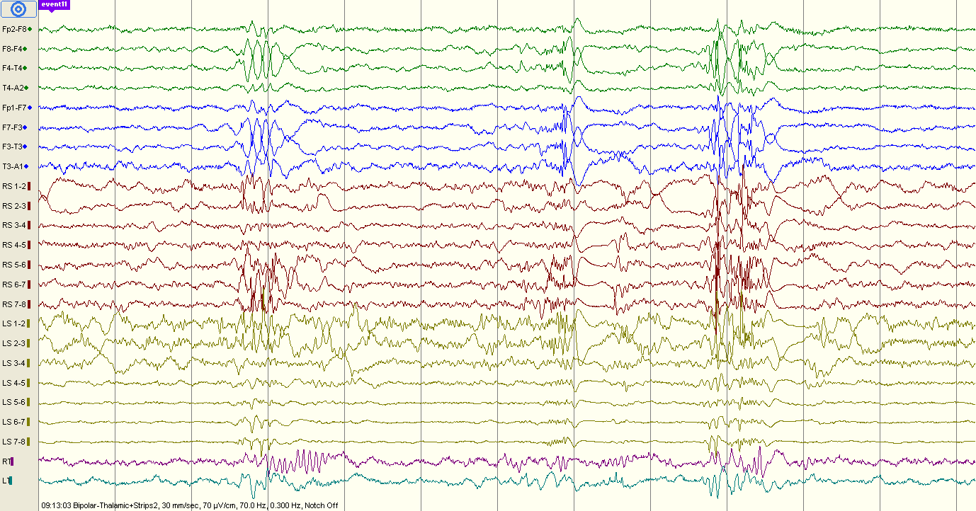

Slide 15
PD
n5zcs\event12.eeg
09:13:52
Seizure, sleeping (slight movement at the end of the seizure)
Bipolar montage
30 mm/sec
70uV/cm
Strips: sensitivity 300
Thalamic: sensitivity 35, High cut 500

Slide 16
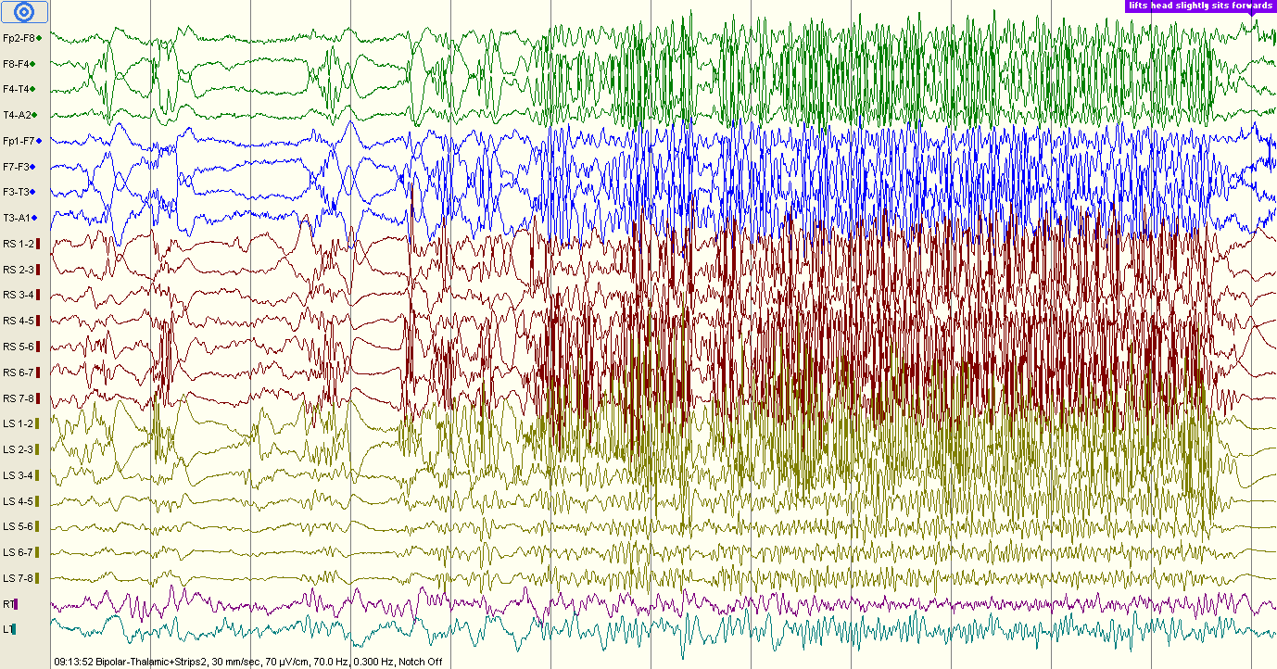

Slide 17
PD
n5zcs\event12.eeg
09:36:52
Seizure, sleeping (wakes up, facial grimacing vs smile, head movement)
Bipolar montage
30 and 60 mm/sec
70uV/cm
Strips: sensitivity 300
Thalamic: sensitivity 35, High cut 500

Slide 18
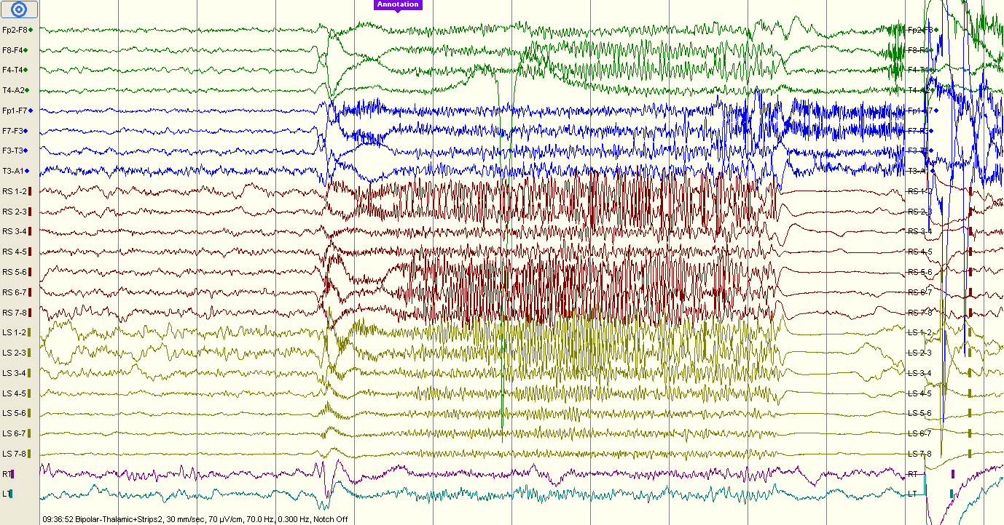

Slide 19
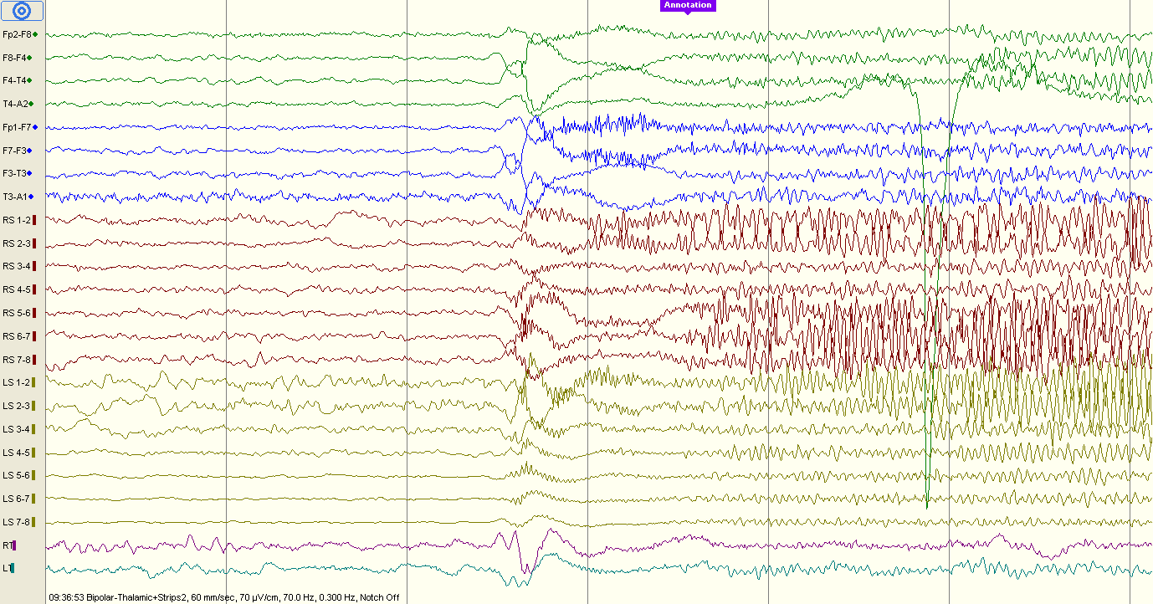

Slide 20
PD
n5zcs\event15.eeg
08:57:11
Seizure
Bipolar montage
30 and 120 mm/sec
70uV/cm
Strips: sensitivity 300
Thalamic: sensitivity 35, High cut 500

Slide 21
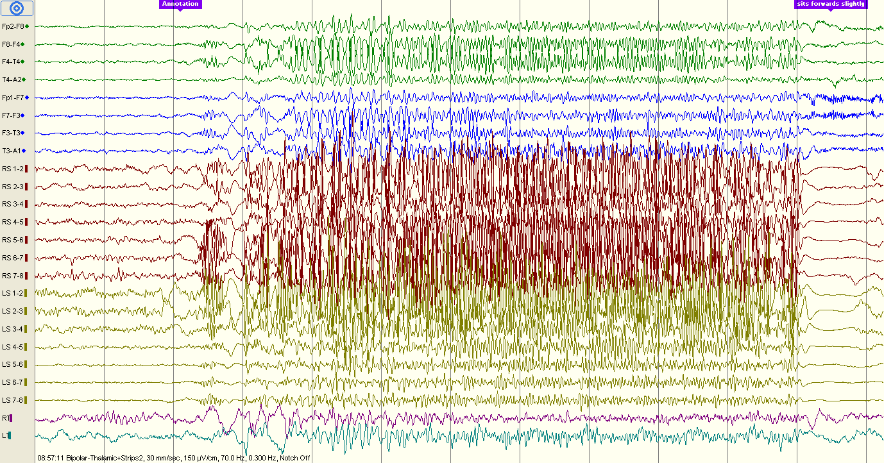

Slide 22
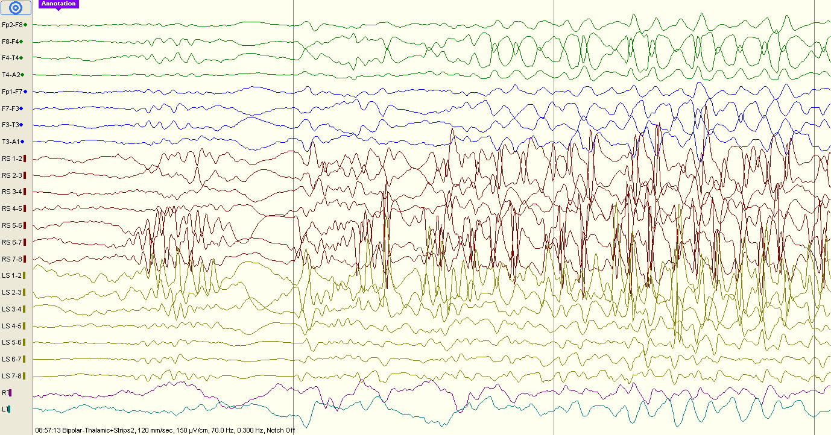

Slide 23
PD
n5zcs\event17.eeg
14:33:40
Seizure
Bipolar montage
30 mm/sec
70uV/cm
Strips: sensitivity 300
Thalamic: sensitivity 35, High cut 500

Slide 24
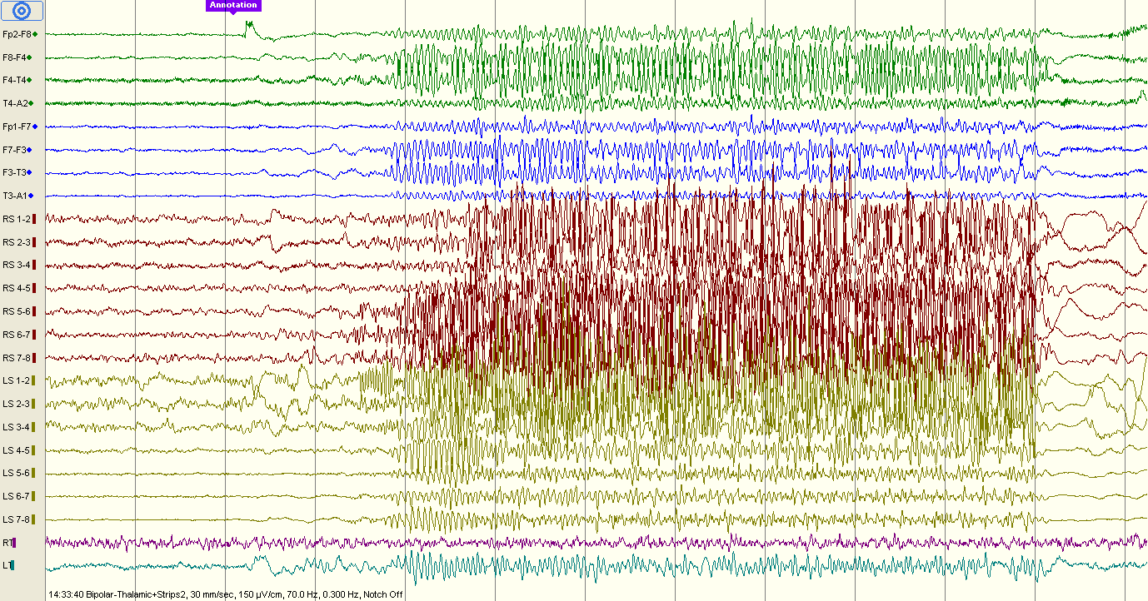

Slide 25
PD
n5zcs\event18.eeg
14:57:24
Seizure? No video
Bipolar montage
30 mm/sec
70uV/cm
Strips: sensitivity 300
Thalamic: sensitivity 35, High cut 500

Slide 26
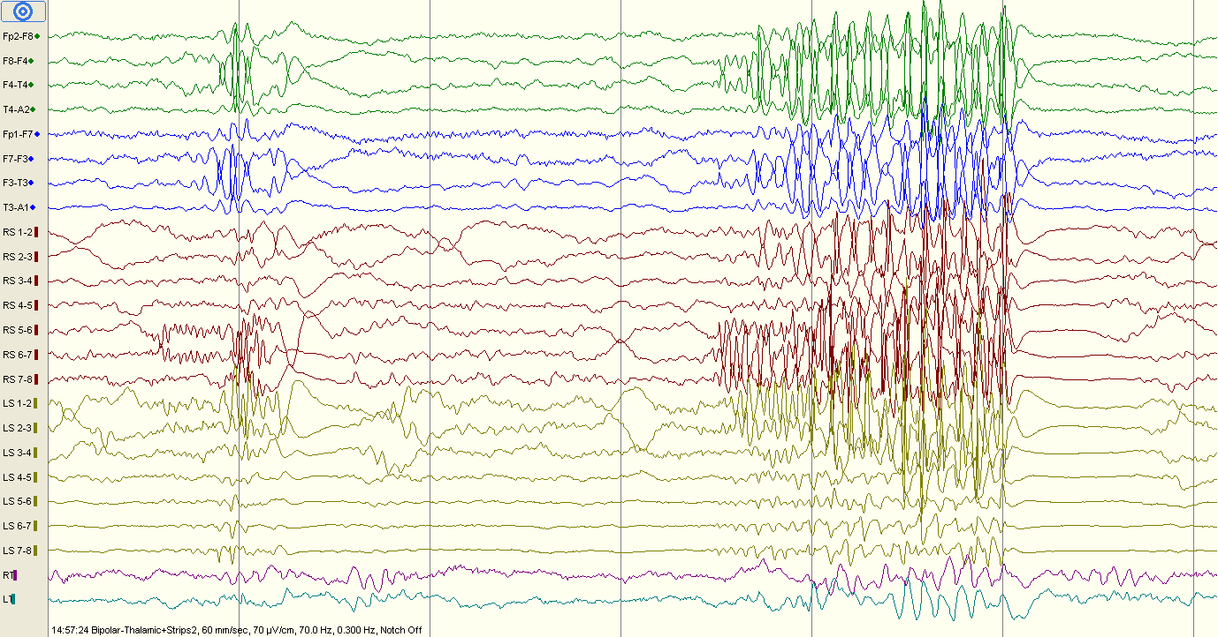

Slide 27
PD
n5zcs\event18.eeg
14:59:16
Seizure? No video
Bipolar montage
120 mm/sec
70uV/cm
Strips: sensitivity 300
Thalamic: sensitivity 35, High cut 500

Slide 28
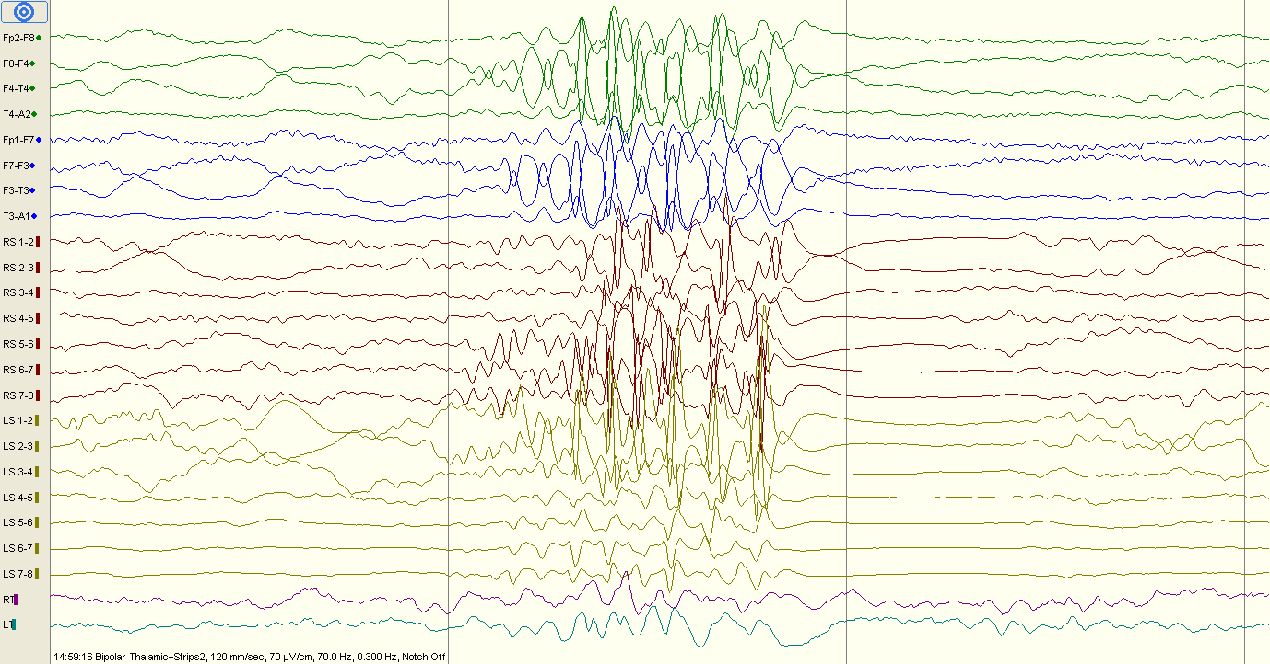

Slide 29
PD
n5zcs\event18.eeg
15:04:42
Bipolar montage
120 mm/sec
70uV/cm
Strips: sensitivity 300
Thalamic: sensitivity 35, High cut 500

Slide 30
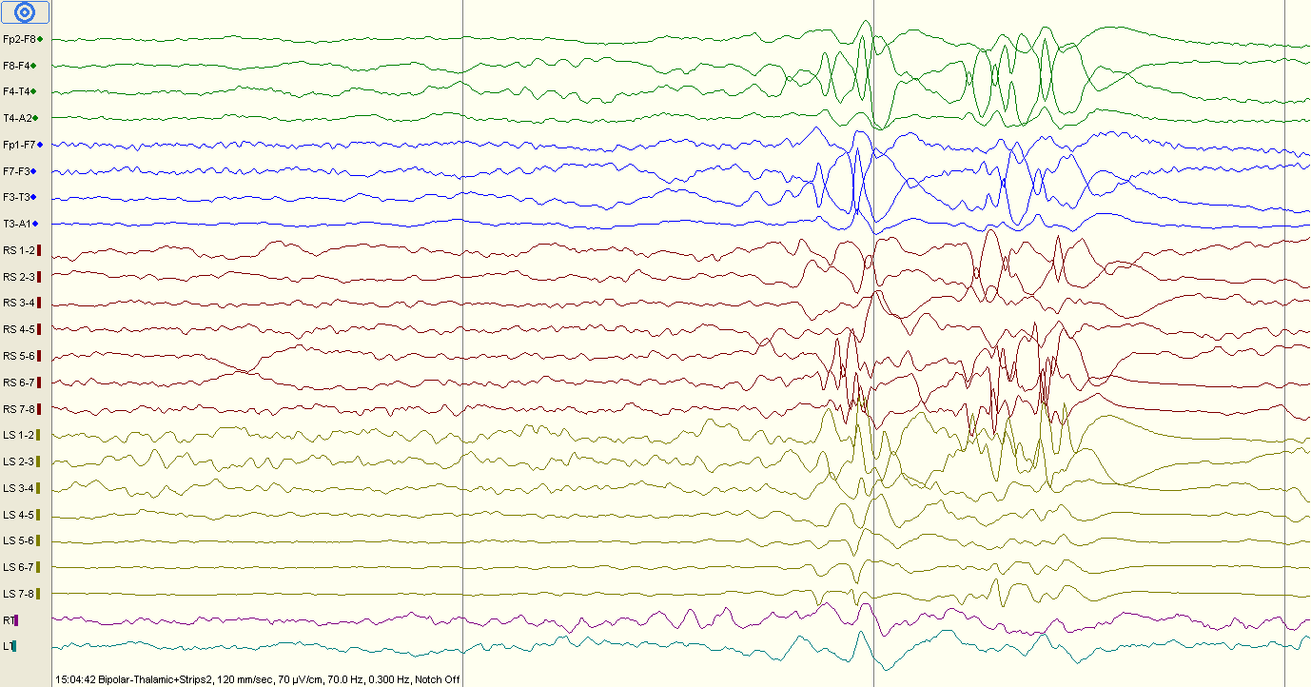

Slide 31
PD
n5zcs\event22.eeg
17:59:14
Bipolar montage
120 mm/sec
150uV/cm
Strips: sensitivity 300
Thalamic: sensitivity 35, High cut 500

Slide 32
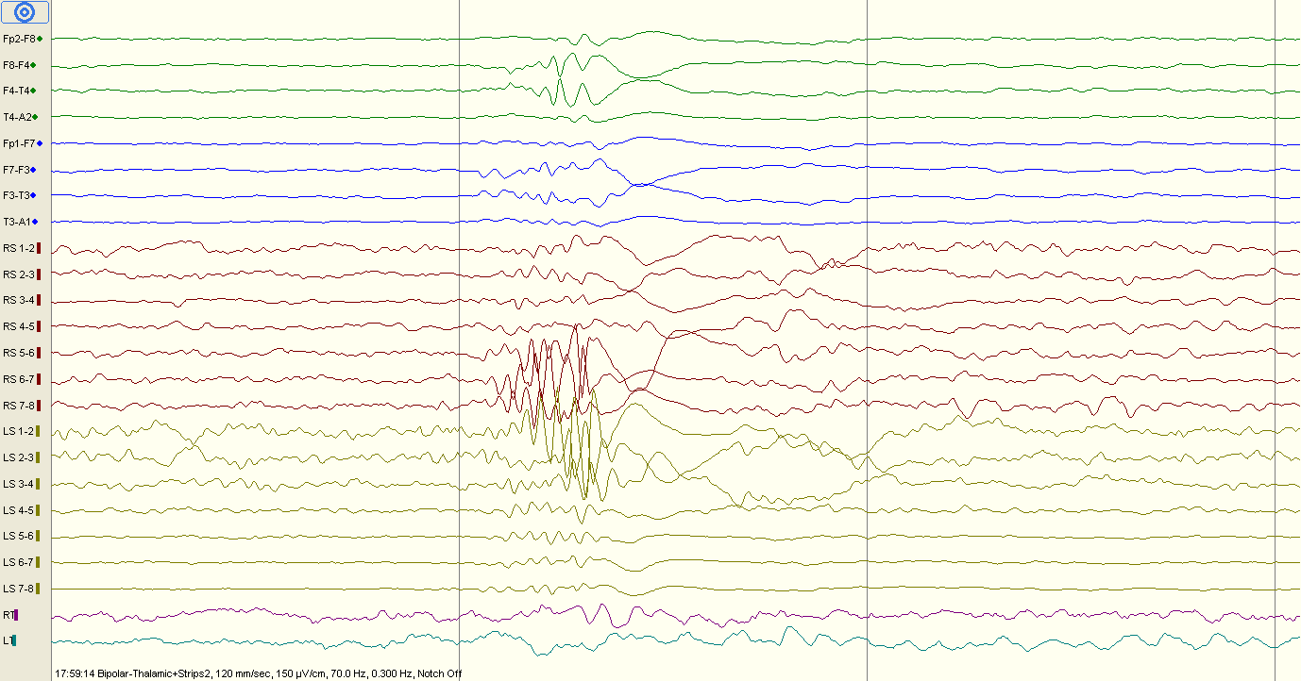

Slide 33
PD
n5zcs\event22.eeg
18:11:47
Bipolar montage
60 mm/sec
70uV/cm
Strips: sensitivity 300
Thalamic: sensitivity 35, High cut 500

Slide 34
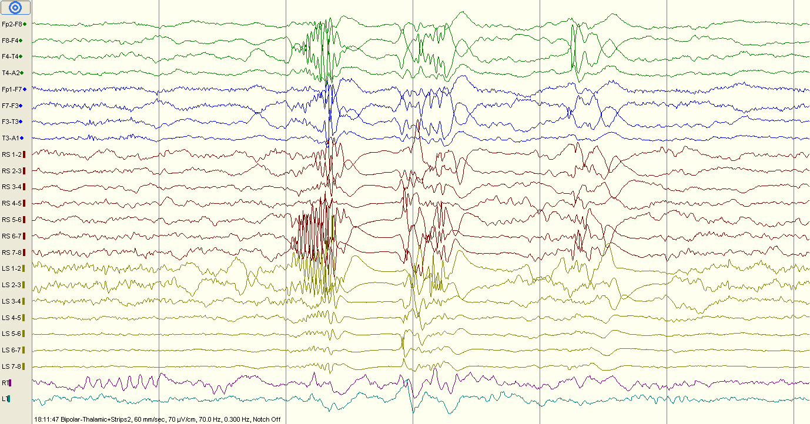

Slide 35
PD
n5zcs\event22.eeg
18:16:08
Bipolar montage
Seizure. No video
30 mm/sec
70uV/cm
Strips: sensitivity 300
Thalamic: sensitivity 35, High cut 500

Slide 36
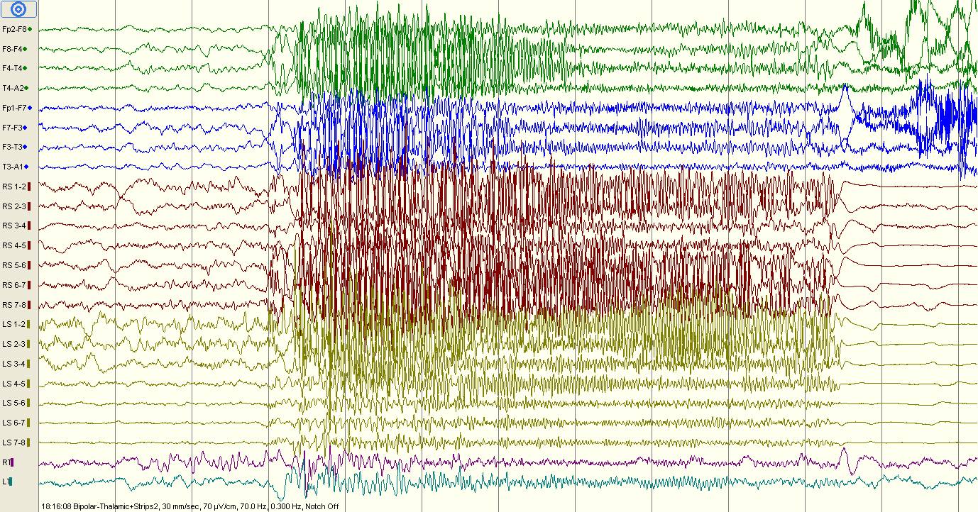

Slide 37
PD
n5zcs\event22.eeg
18:33:51
Bipolar montage
Seizure. No video
20 mm/sec
70uV/cm
Strips: sensitivity 300
Thalamic: sensitivity 35, High cut 500

Slide 38
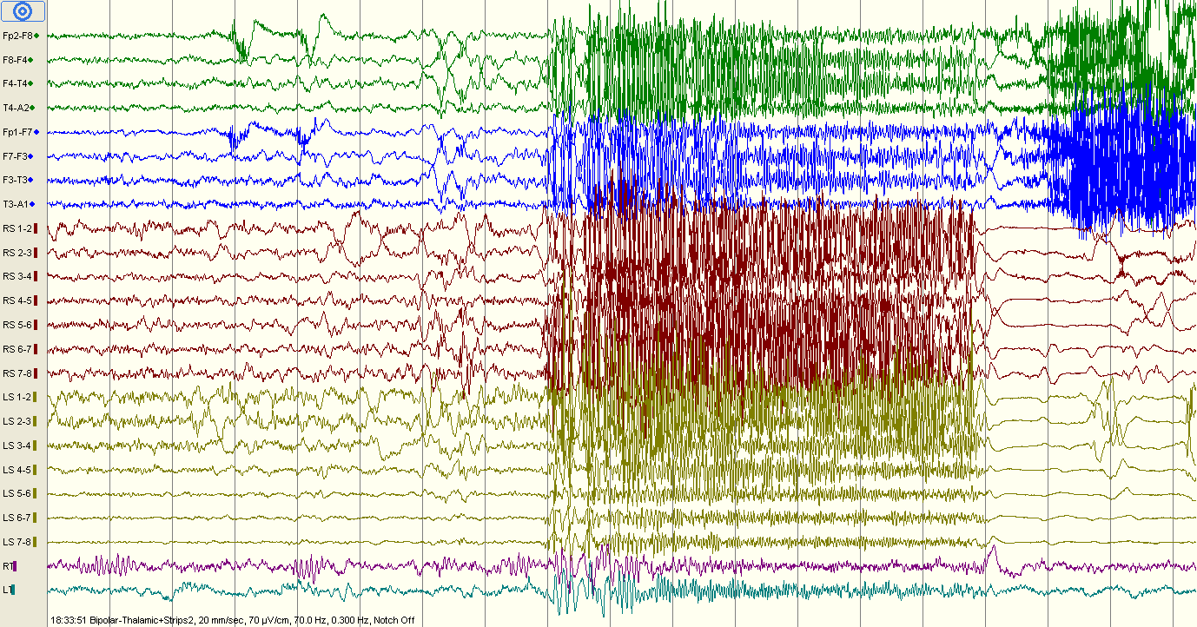

Slide 39
PD
n5zcs\event22.eeg
18:44:07
Bipolar montage
Seizure. No video
30 mm/sec
70uV/cm
Strips: sensitivity 300
Thalamic: sensitivity 35, High cut 500

Slide 40
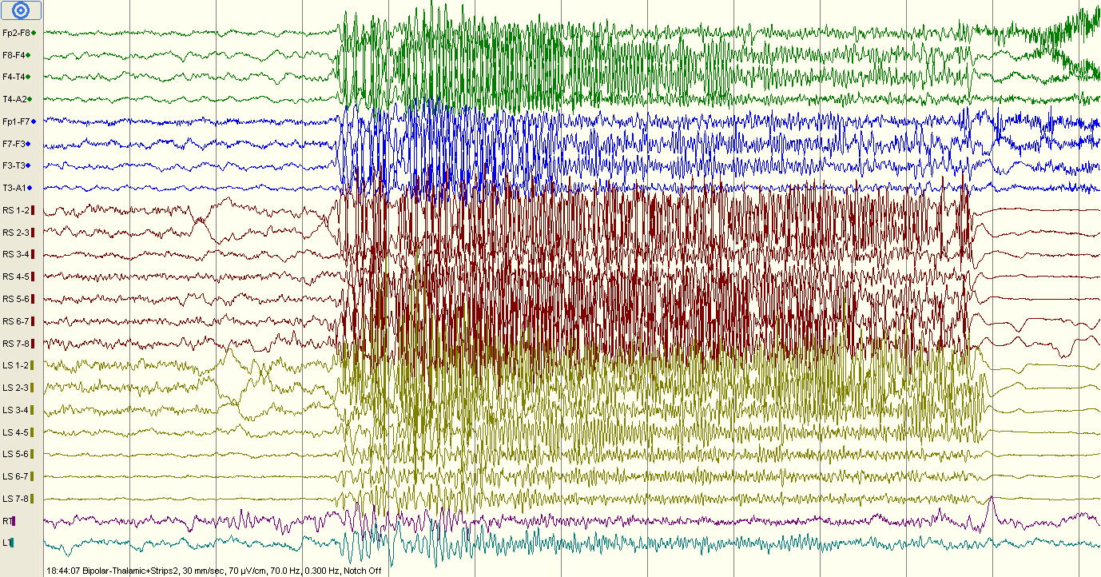

Slide 41
PD
n5zcs\event23.eeg
15:09:31
Bipolar montage
Seizure. Smile and slight head movement.
30 mm/sec
70uV/cm
Strips: sensitivity 300
Thalamic: sensitivity 35, High cut 500

Slide 42
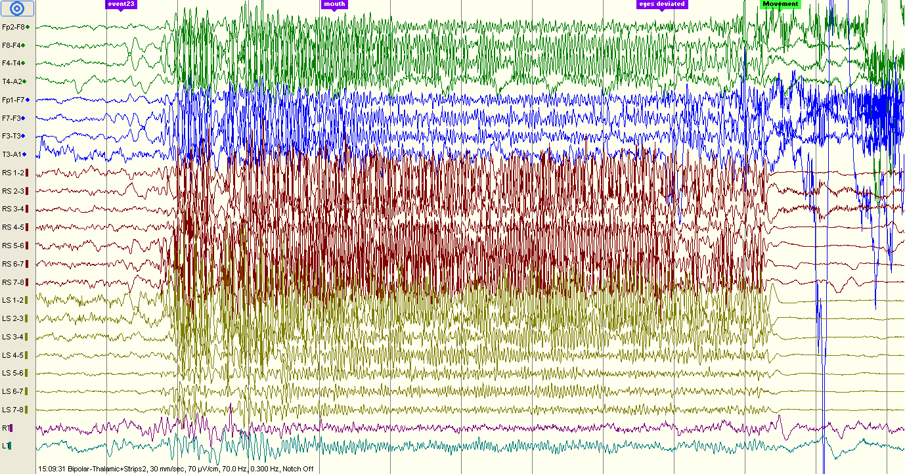

Slide 43
PD
n5zcs\event24.eeg
15:09:31
Bipolar montage
Seizure. No video (annotations: mouht, eyes deviated)
30 mm/sec
70uV/cm
Strips: sensitivity 300
Thalamic: sensitivity 35, High cut 500

Slide 45
PD
n5zcs\event25.eeg
23:24:16
Bipolar montage
Seizure. No video
30 mm/sec
70uV/cm
Strips: sensitivity 300
Thalamic: sensitivity 35, High cut 500

Slide 46
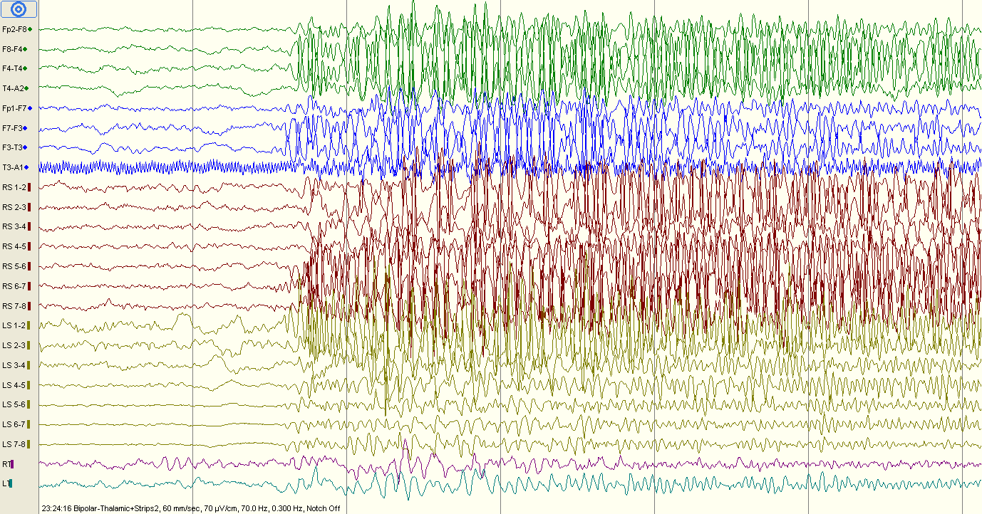

Slide 47
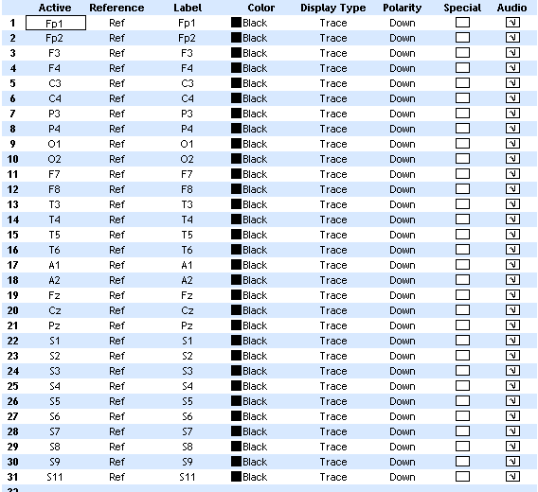
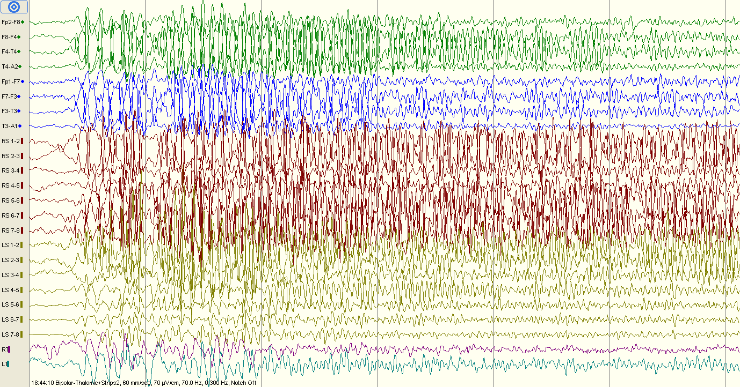
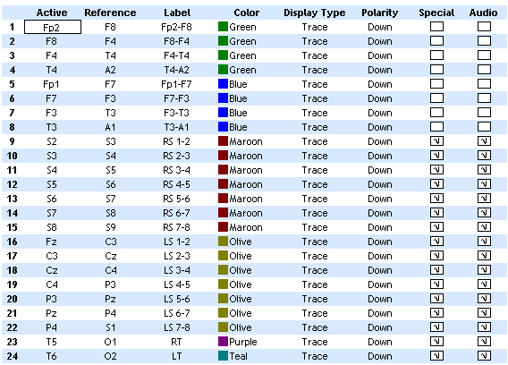
Pruned recording
Notes:
n5zcs\event22.eeg
18:16:08
Bipolar montage
Seizure. No video
30 mm/sec
70uV/cm
Strips: sensitivity 300
Thalamic: sensitivity 25, High cut 500

Slide 48
